Slide 1
Final project
Xiran He

Slide 2

content
Background
Source
Process
Result
Conclusion
Improvement

Slide 3
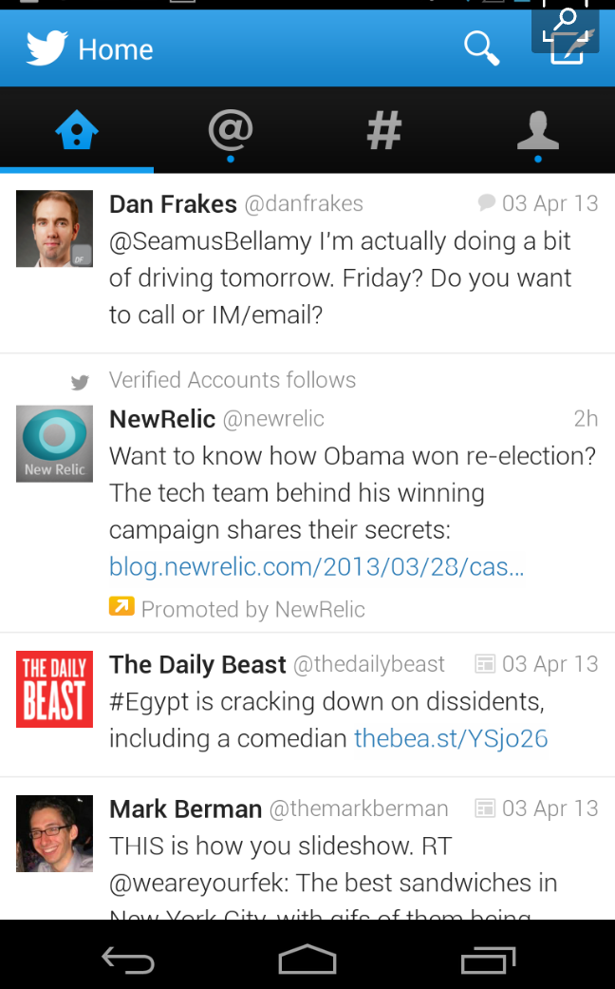

Background
Notes:
304 million monthly active users
200 million monthly active users
1.1 billion monthly active users

Slide 4
Source
negative-words.txt & positive-words.txt:
http://www.cs.uic.edu/~liub/FBS/sentiment-analysis.html
Minqing Hu and Bing Liu. "Mining and Summarizing Customer Reviews."
Tweets that refer Trump from 2017.11.1 – 2017.11.30:
Twitter
The approval rating of Trump:
http://news.gallup.com/poll/201617/gallup-daily-trump-job-approval.aspx

Slide 5
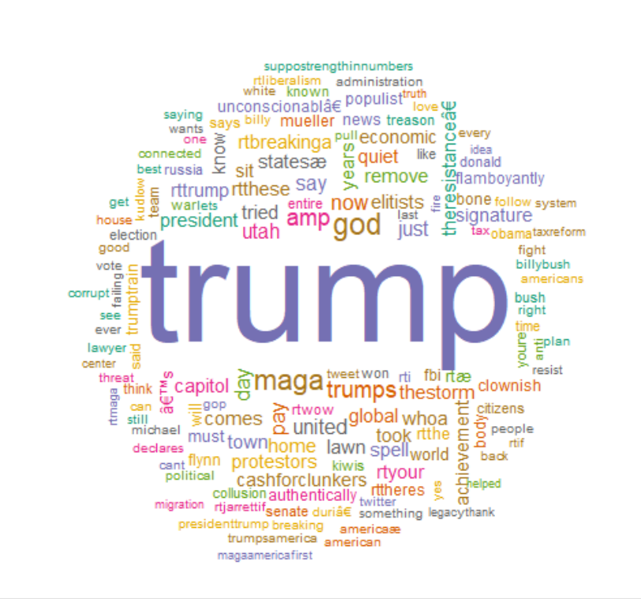
Process
Creating Word Cloud
1) Using Twitter developers to Create a Twitter Application
2) Extract tweets: key words
3) Clean up Text and remove stop words
4) Generate World Cloud
Notes:
Step1: Consumer Key (API Key), Consumer Secret (API Secret), Access Token, and Access Token Secret
would help you to extract tweets by using R

Slide 6
Process
Sentiment Analysis
Read negative&positive words.txt
Scoring tweets
Extract 500 tweets
Calculate
Notes:
Step2: removes graphic characters #like emoticons
removes punctuation and control characters
splits the tweets by word in a list
converts matching values to true of false
true and false are treated as 1 and 0 so they can be added

Slide 7
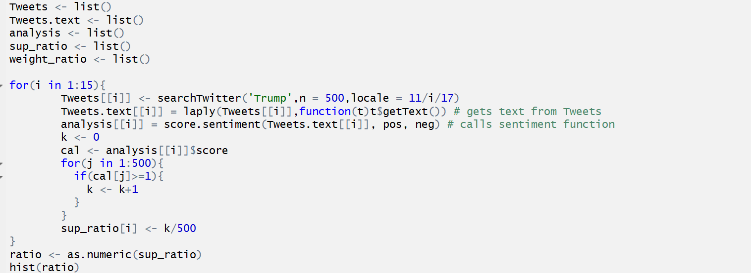
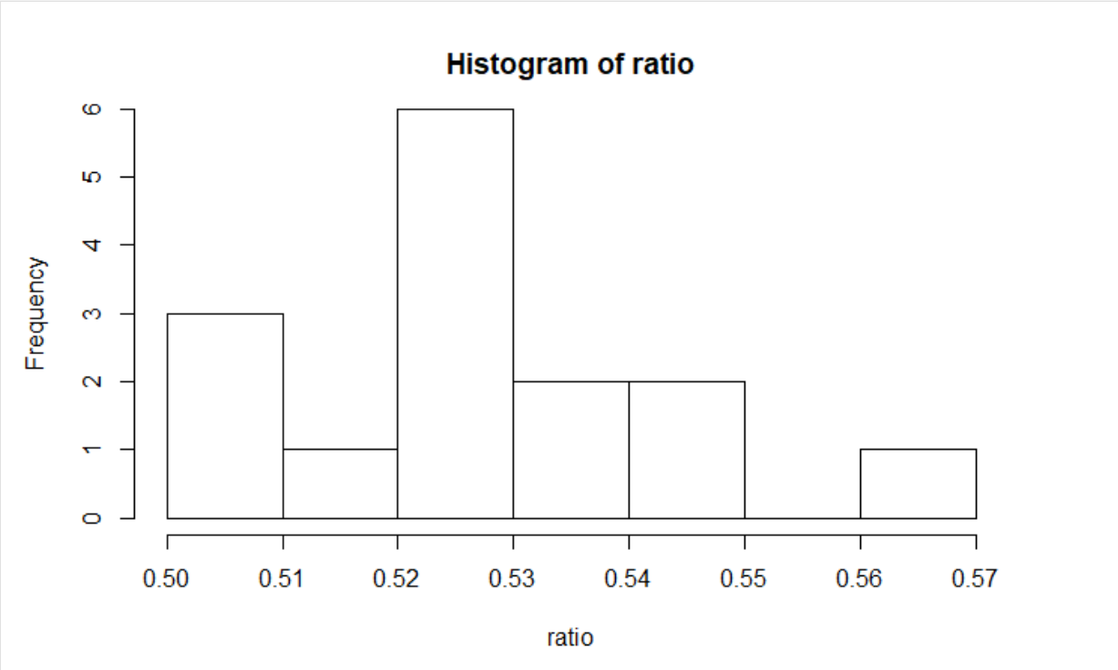
Process

Slide 8
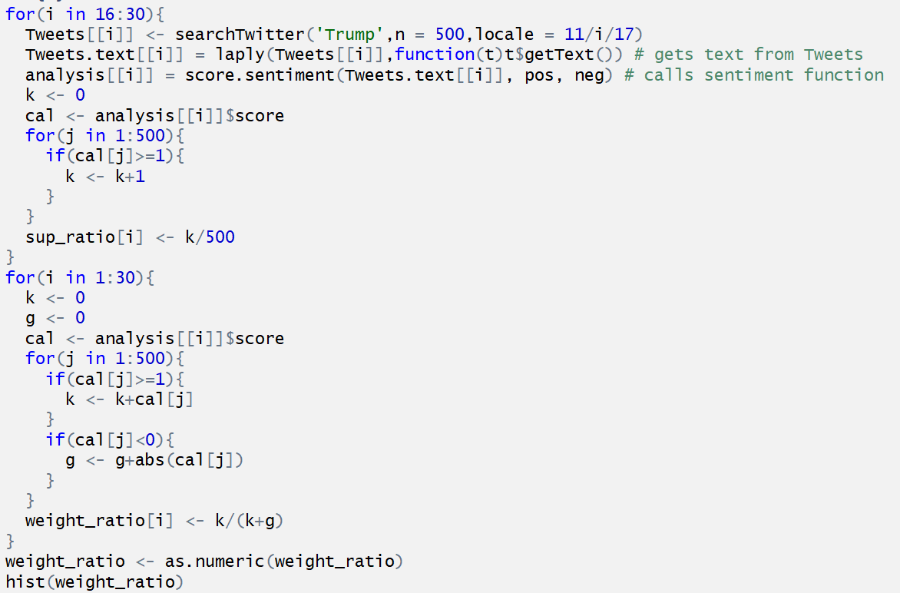
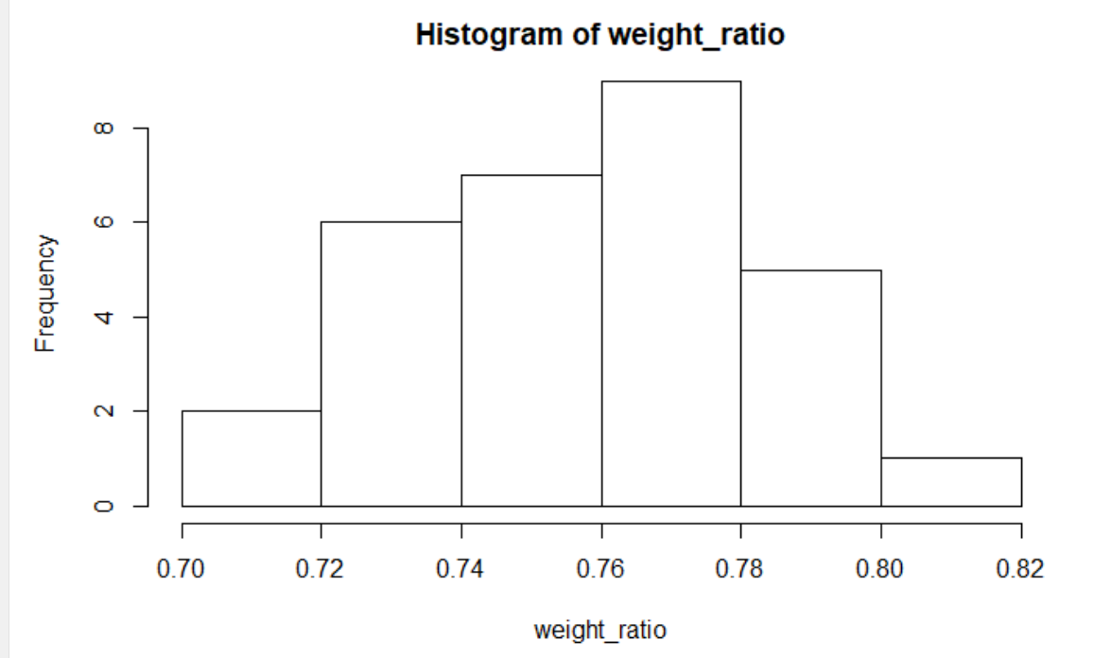
Process

Slide 9
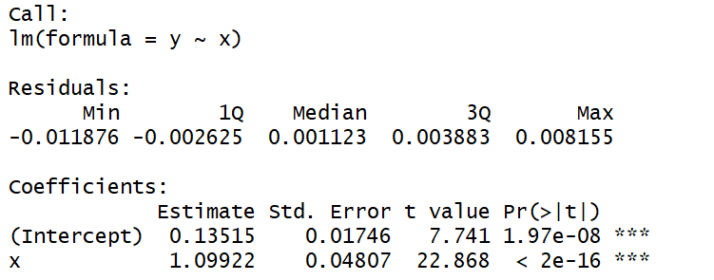
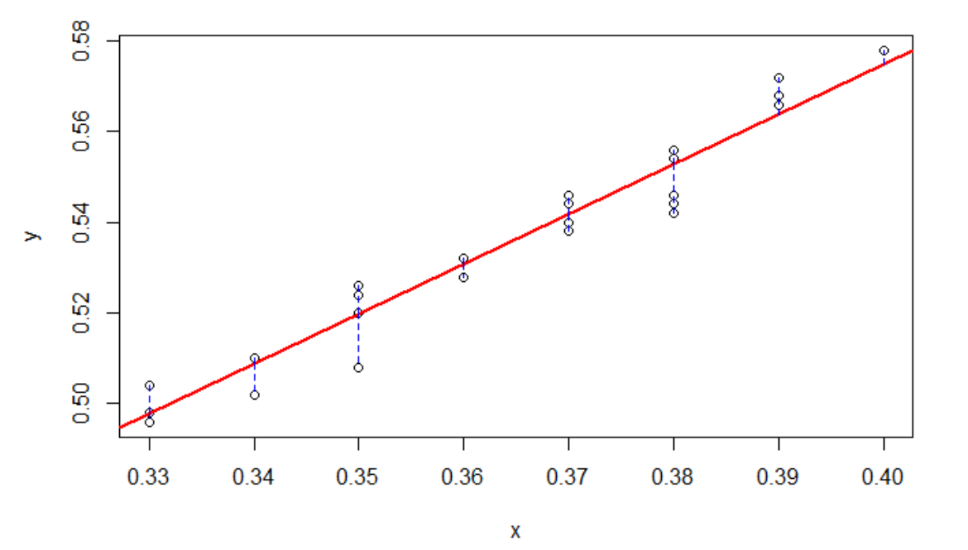
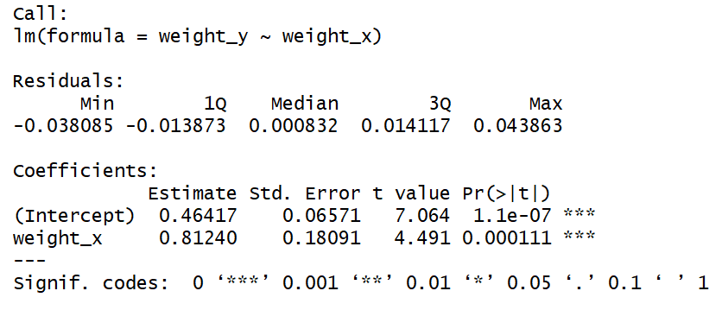
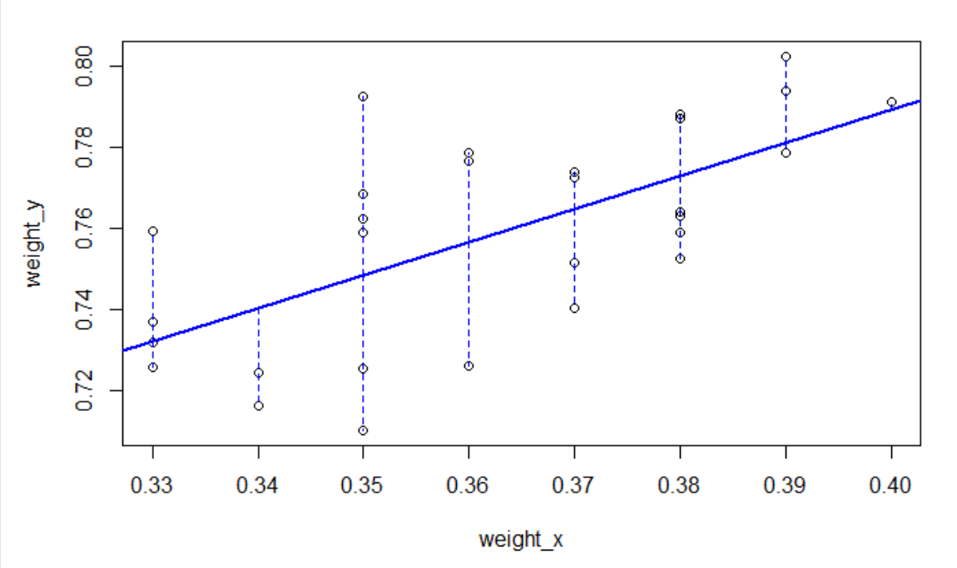
Result

Slide 10
Conclusion
y*attitude = 1.09922*approval rating + 0.13515
Y*weight_attitude = 0.8124*approval rating + 0.46417

